Slide 1

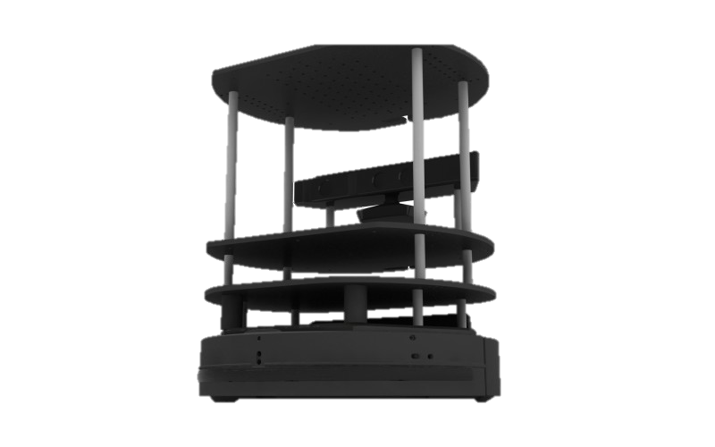
ROS-Turtlebot
Motion Control and Navigation
Yannick PORTO – Mashruf CHOWDHURY – AK ASSAD

Slide 2

Introduction
ROS
Open Source
Operating System Middleware
Code Reuse
Community Support
Turtlebot
Low-Cost robot
Combines popular robot components

Slide 3
Contents
1. Motion Control
2. Navigation & Localization
3. Android control

Slide 4
Motion Control

Slide 5
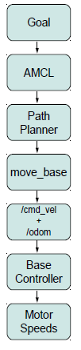
Levels of Motion Control
1. Motors, Wheels and Encoders
2. Motor Controllers and Drivers
3. The ROS Base Controller
4. Frame-Base Motion using the move base ROS Package
5. SLAM using the gmapping and amcl ROS Packages
6. Semantic Goals

Slide 6
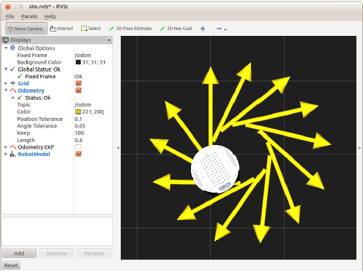
Twisting and Turning with ROS
ROS uses the Twist message type (see details below) for publishing motion commands to be used by the base controller. The base controller node subscribes to the /cmd_vel topic and translates Twist messages into motor signals that actually turn the wheels.
$rosmsg show geometry_msgs/Twist
geometry_msgs/Vector3 linear
float64 x
float64 y
float64 z
geometry_msgs/Vector3 angular
float64 x
float64 y
float64 z
$rostopic pub -r 10 /cmd_vel geometry_msgs/Twist ’{linear: {x: 0.15, y: 0, z: 0}, angular: {x: 0, y: 0, z: -0.4}}’

Slide 7
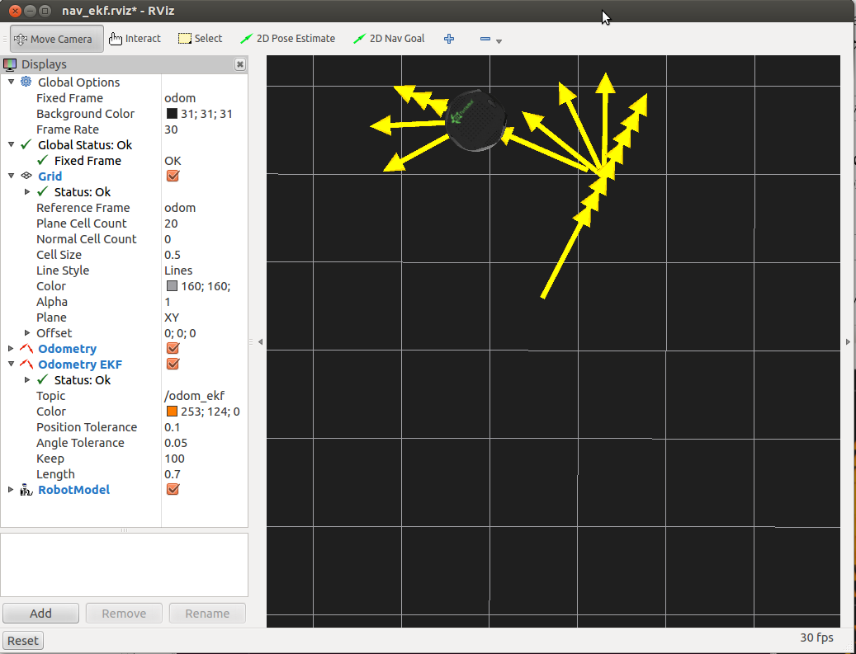
Goal 1 : Basic Motion of Mobile Base
Algorithm 1: Time and Speed based out and back (
$rosrun rbx1_nav timed_out_and_back.py)
rate = 50
goal_distance = 1.0 m
linear_speed = 0.2m/s
linear_duration = goal_distance / linear_speed;
angular_speed = 1.0
goal_angle = pi
angular_duration = goal_angle / angular_speed;
A: Repeat step 1 to 6 twice
1. ticks = linear_duration / rate
2. while(t < ticks)
robot will walk 1 meter straight
3. robot will sleep 1 cycle
4. ticks = goal_angle * rate
5. while(t<ticks)
robot rotates 180*
6. robot will sleep 1 cycle
B: Program Terminates

Slide 8
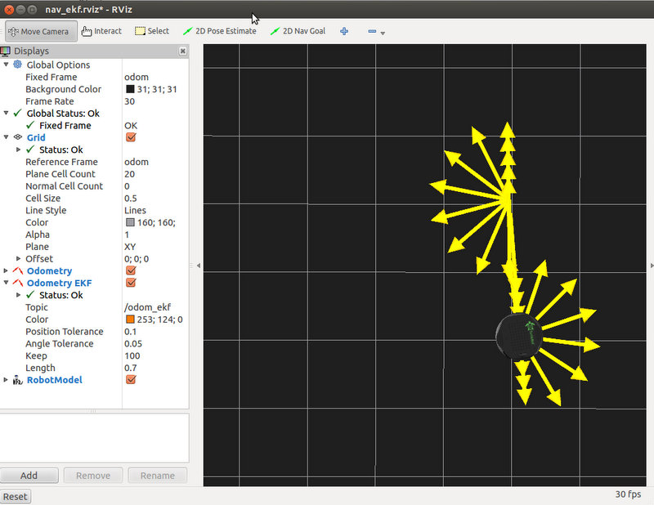
Goal 2 : Advanced Motion of Mobile Base
Algorithm 2: ODOMETRY based out and back (odom_out_and_back.py)
rate = 50
goal_distance = 1.0 m
linear_speed = 0.2m/s
linear_duration = goal_distance / linear_speed;
angular_speed = 1.0
goal_angle = pi
angular_duration = goal_angle / angular_speed;
A: Repeat step 1 to 6 twice
1. get initial position
2. while distance < goal_distance
robot will go at a speed set by linear_speed
sleep 1 cycle
get new linear position from ODOMETRY
calculate new distance from new position and
old position
3. stop the robot
Set last_angle = rotation
turn_angle = 0
4. while (turn_angle < goal_angle)
start rotating
sleep 1 cycle
get new rotation position from ODOMETRY
delta_angle = (rotation - last_angle)
turn_angle += delta_angle
last_angle = rotation
5. stop the robot 1 cycle before next run
B: Program Terminates

Slide 9
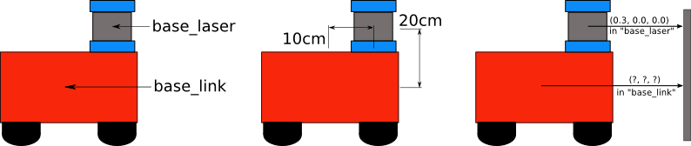
Goal 2 : Advanced Motion of Mobile Base
Turtlebot Odometry data we use to move the robot. While the /base link frame corresponds to a real physical part of Controlling a Mobile Base robot, the /odom frame is defined by the translations and rotations encapsulated in the odometry data.

Slide 10
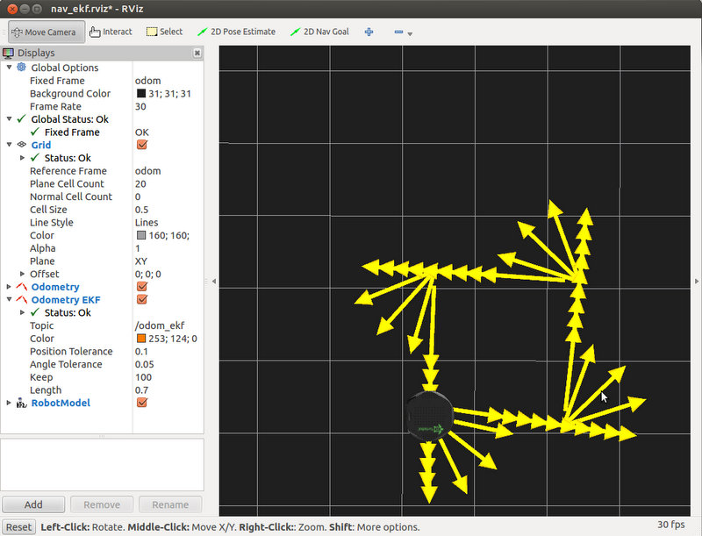
Goal 3 : Navigating a Square using Twist+Odometry
The difference is that it we now send the robot along four 1 meter legs using 90 degree rotations instead of two 1 meter
legs using 180 rotations.
At the end of the run, we can see that the errors accumulated in odometry are visible, it didn’t move in a perfect square.

Slide 11
Navigation & Localization

Slide 12
Outline
Navigation Concepts
Map, Robot Pose and Path Planning
Taxonomy of Navigation
Localization
Planning
Building a Map
Building the Map

Slide 13
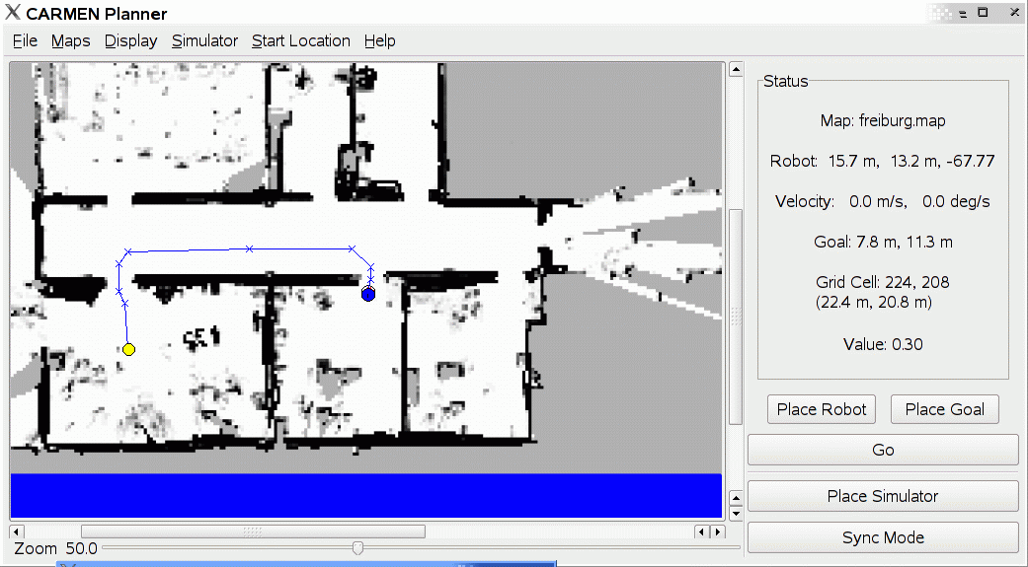
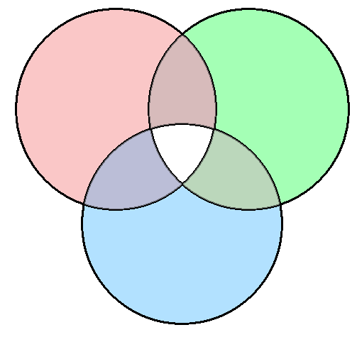
Sense - Plan - Act
To accomplish a task, a robot should “understand” the environment from it sensor measurements.
Understanding: capturing the information at the right level of abstraction.
An autonomously navigating robot should know what the environment (slam_gmapping) looks like and where it is in the environment (AMCL)
mapping
SLAM
localization
exploration
Active localization
Path planning

Slide 14
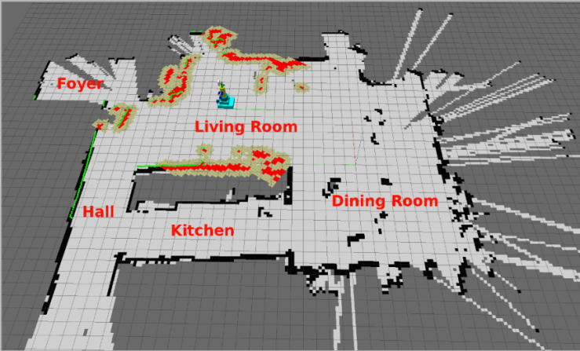
Mapping using SLAM
A map is a representation of the environment where the robot is operating.
SLAM= Simultaneous Localization and Mapping
Estimate: the map of the environment, the trajectory of a moving device using a sequence of sensor measurements.

Slide 15
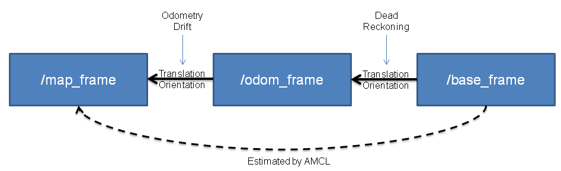
Localizing Turtlebot using AMCL
AMCL uses a particle filter to track the position of the robot, particles are moved according to (relative) movement measured by the odometry.
Suppressed/replicated based on how well the laser scan fits the map, given the position of the particle.
The localization is integrated in ROS by emitting a transform from a map-frame to the odom frame that “corrects” the odometry.
To query the robot position according to the localization should ask the transform of base_footprint in the map frame.

Slide 16
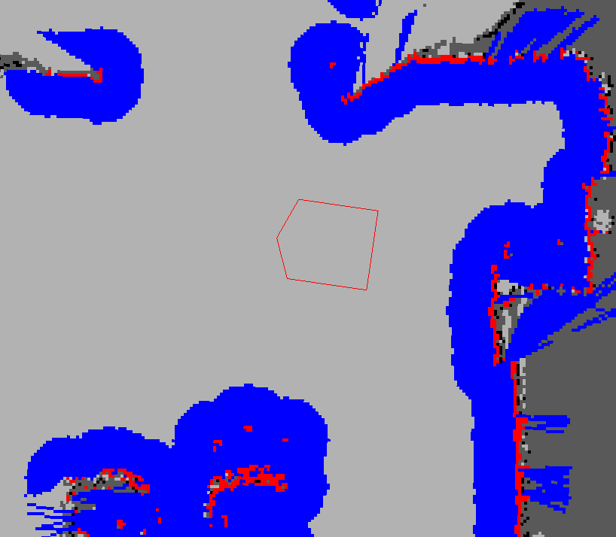
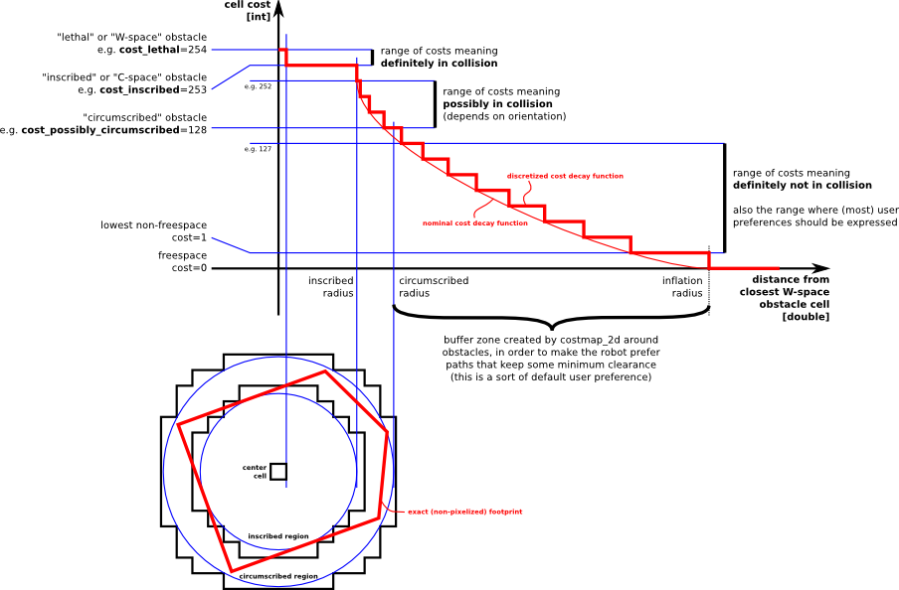
Putting Parts Together
To navigate a robot
A map
A localization module
A path planning module
Ideal environment
It is dynamic (things might appear/disappear from the perception range of the robot)
The estimation is “noisy”
Implementation of Obstacle-Detection/Avoidance Path-Planning using move_base to refinement the local map, based on the most recent sensor reading.

Slide 17
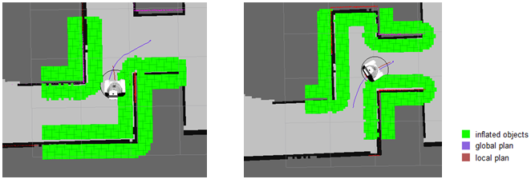
move_base to Reach the Goal
Path-planning and Obstacle avoidance
Node uses four important configuration files
Cost map generation
Uses A* Algorithm

Slide 18
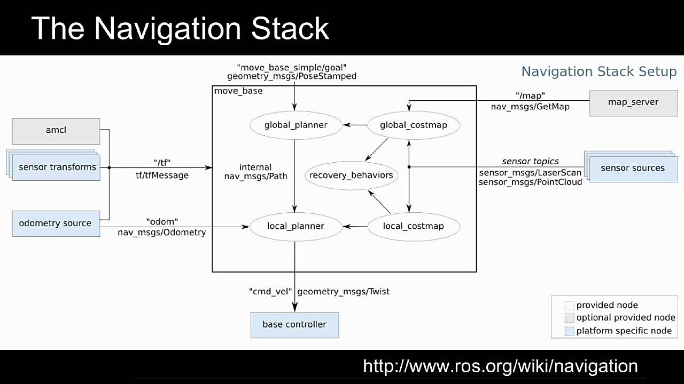
ROS Navigation Stack
Map provided by a “Map Server”
Each module is a node
Planner has a layered architecture (local and global planner)
Obstacle sensing refined on-line by appropriate modules (local and global costmap)

Slide 19
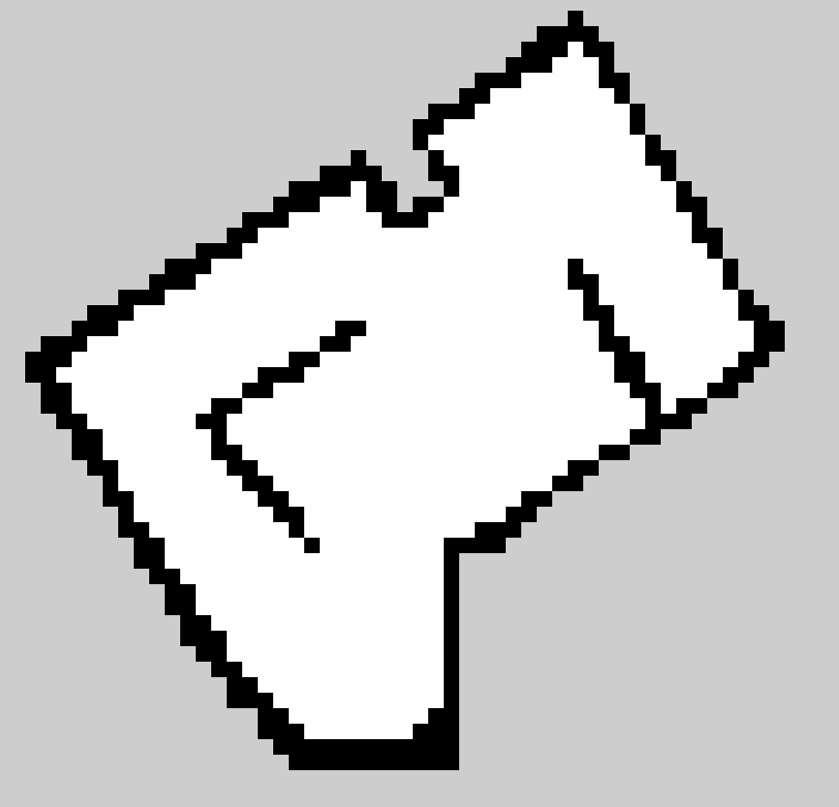

Building the Map
ROS uses GMapping, which implements a particle filter to track the robot trajectories.
The map is an occupancy grid map and it is represented as an image showing the blueprint of the environment
A configuration file (yaml) that gives meta information about the map (origin, size of a pixel in real world)

Slide 20
Autonomous Navigation
Autonomous navigation is based on move_base in action
VIDEO

Slide 21
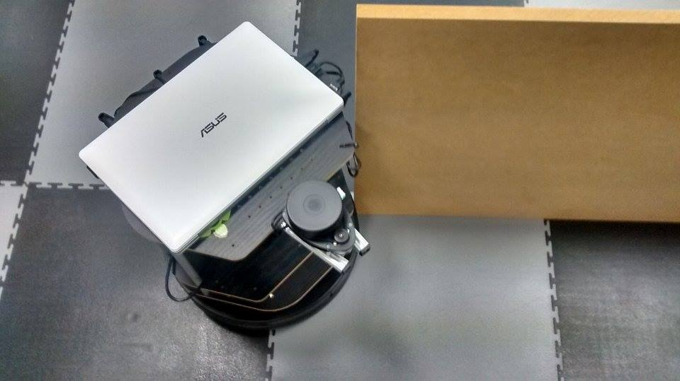
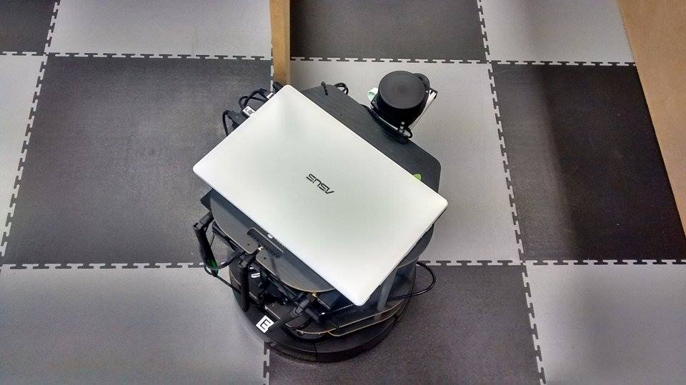
Navigation Problems
VIDEO

Slide 22
Android Control
Pairing and Demonstration

Slide 23
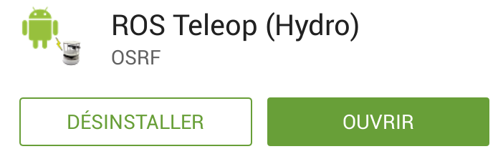
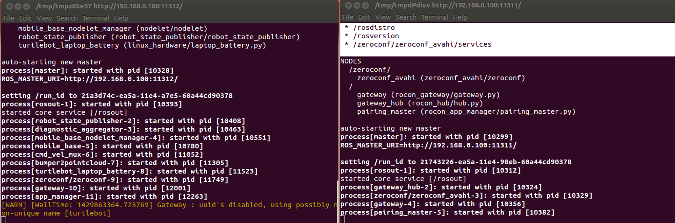
Pairing
Connect on the same Network
Download ROS Teleop (Hydro)
Bringup with concert file

Slide 24
Android App
Joystick
Publishes Twist Messages
Feed view
Polls camera topic and displays the received data on screen

Slide 25
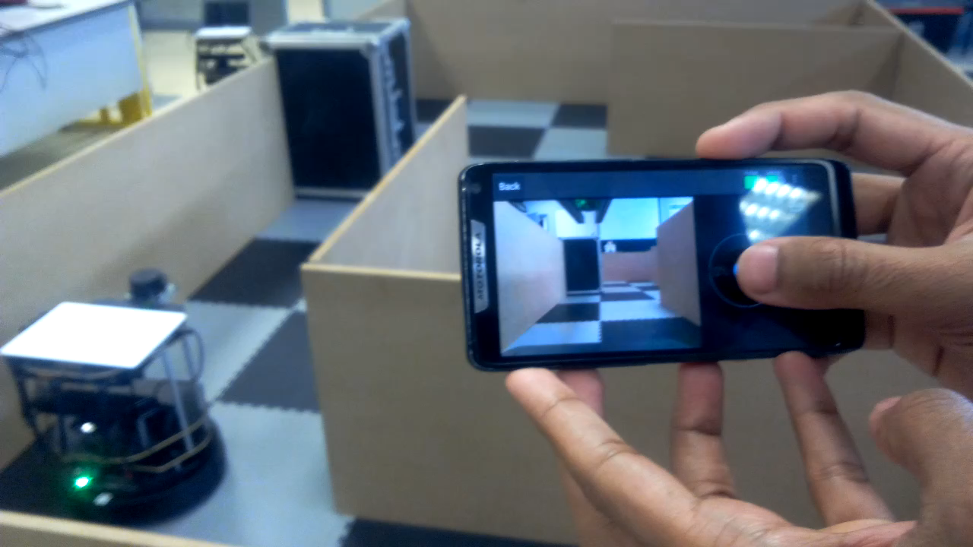
Demonstration
https://www.youtube.com/watch?v=pBYmtod4o18

Slide 26
Conclusion
ROS
Powerful tool
Navigation
A lot of parameters
Android
Time spent on code

